Slide 1

Chatter
Team Name: Elite 3

Slide 2
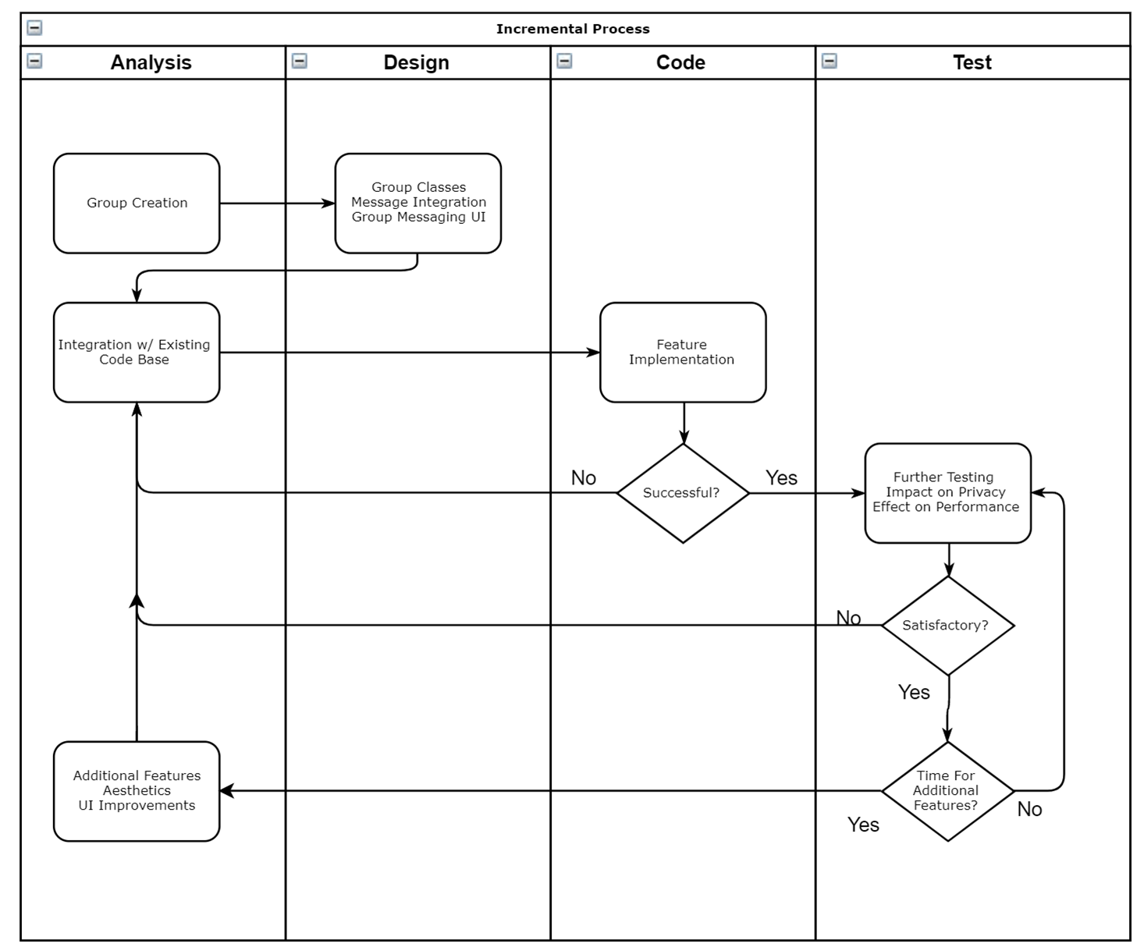
Overview
Continuing Incremental Process
Entering Final Testing Phases

Slide 3
Roles, Progress, & Ongoing Plan
Mary - Chatter Website Design and Implementation
Currently Working On: Website Feedback Confirmation, Website Testing
Sam - Chatter iOS Application Design and Implementation
Currently Working On: Social Media Integration, Application Testing
Brandon - Documentation and Diagrams
Currently Working On: Testing Procedures, Integration Testing

Slide 4

Test Coverage Issues
Integration Testing All Components
Performance Testing
Covering All Use Cases

Slide 5
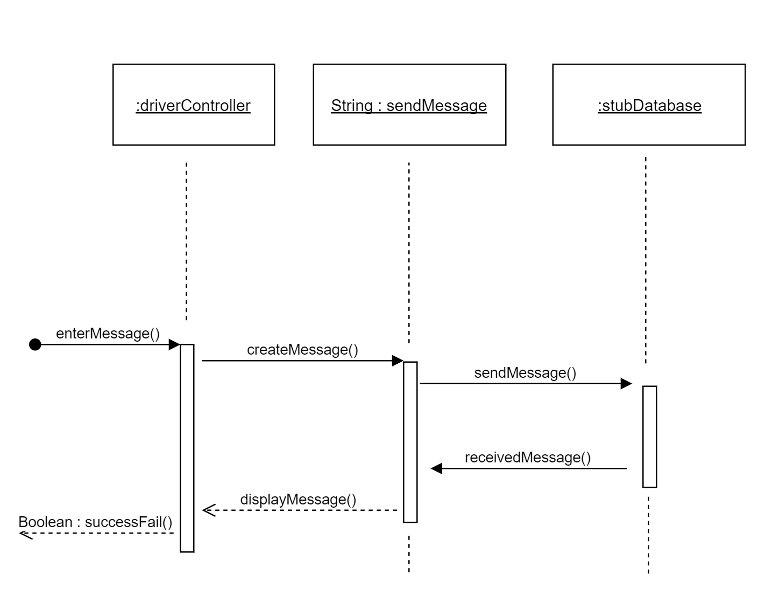
Key Unit Tests
Messaging

Slide 6
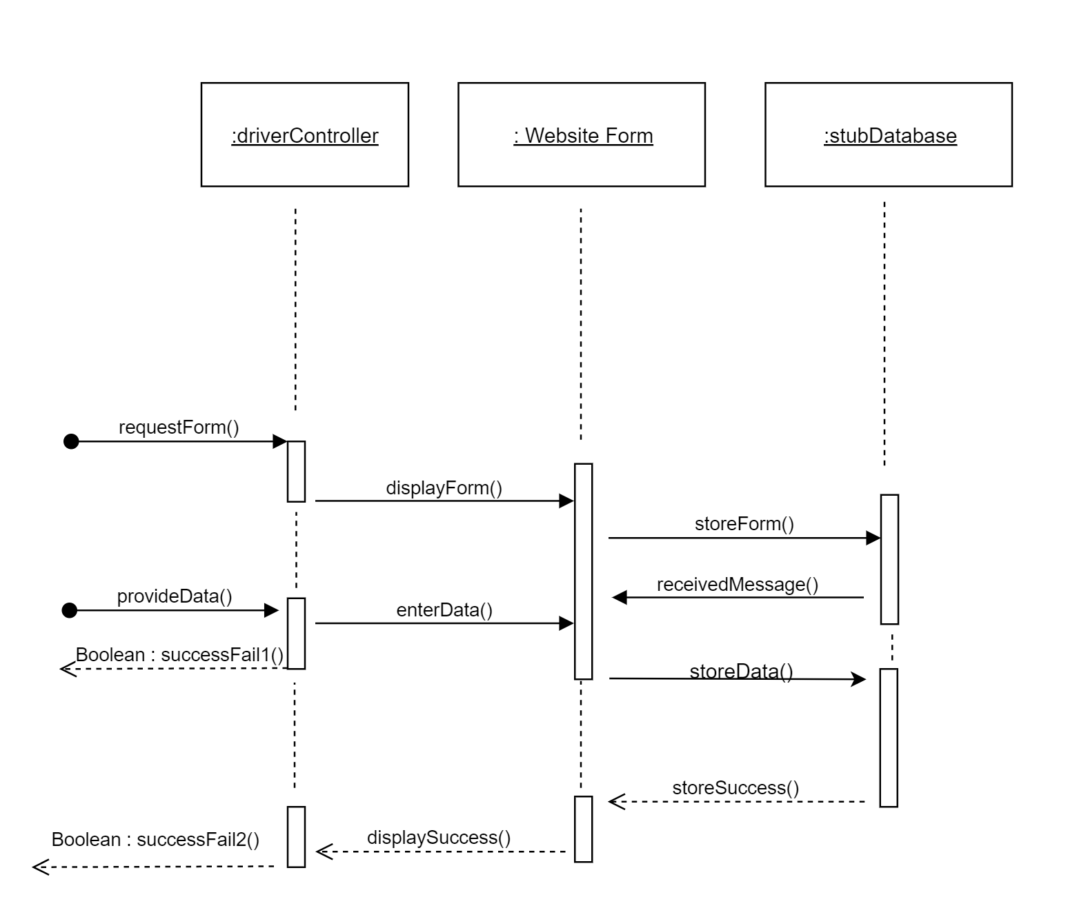
Key Unit Tests
Feedback

Slide 7
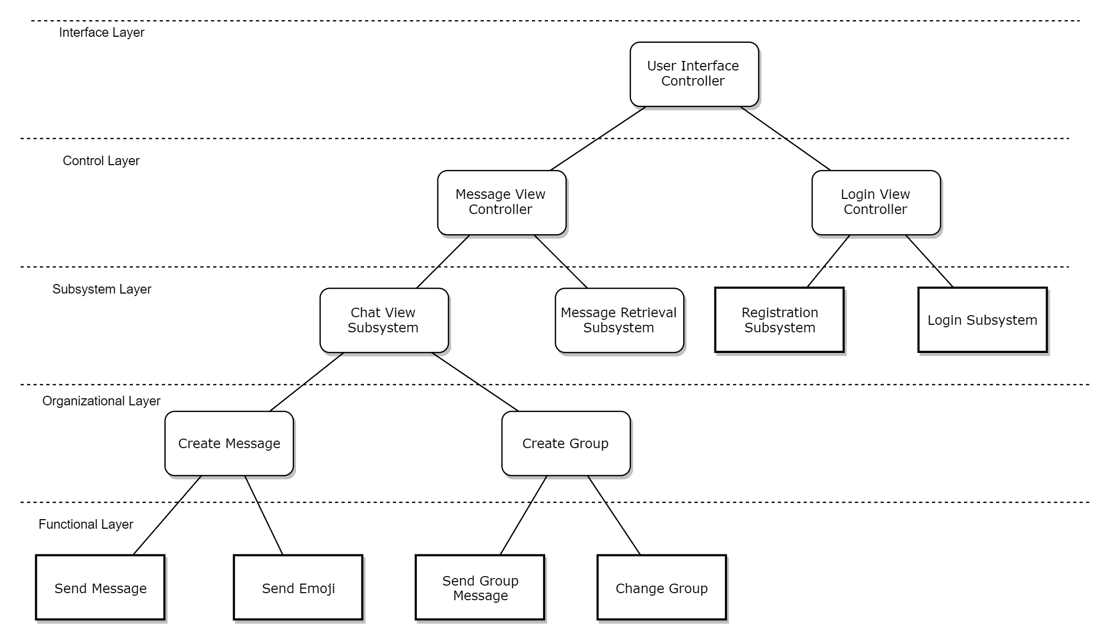
Integration Testing - Layers

Slide 8
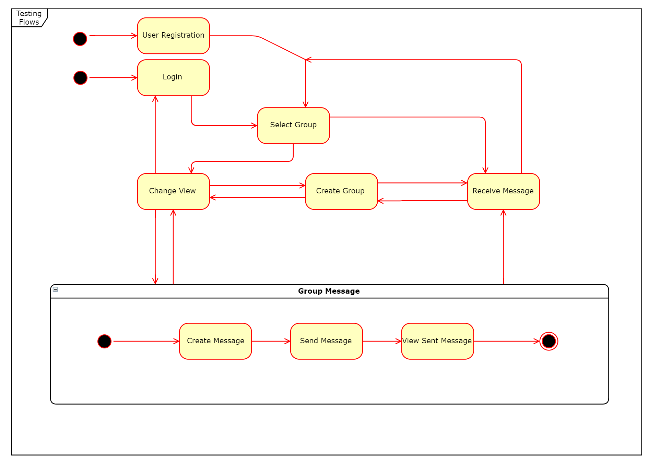
System Testing
Functional Testing
State Diagram
Many Different Paths
Performance Testing

Slide 9
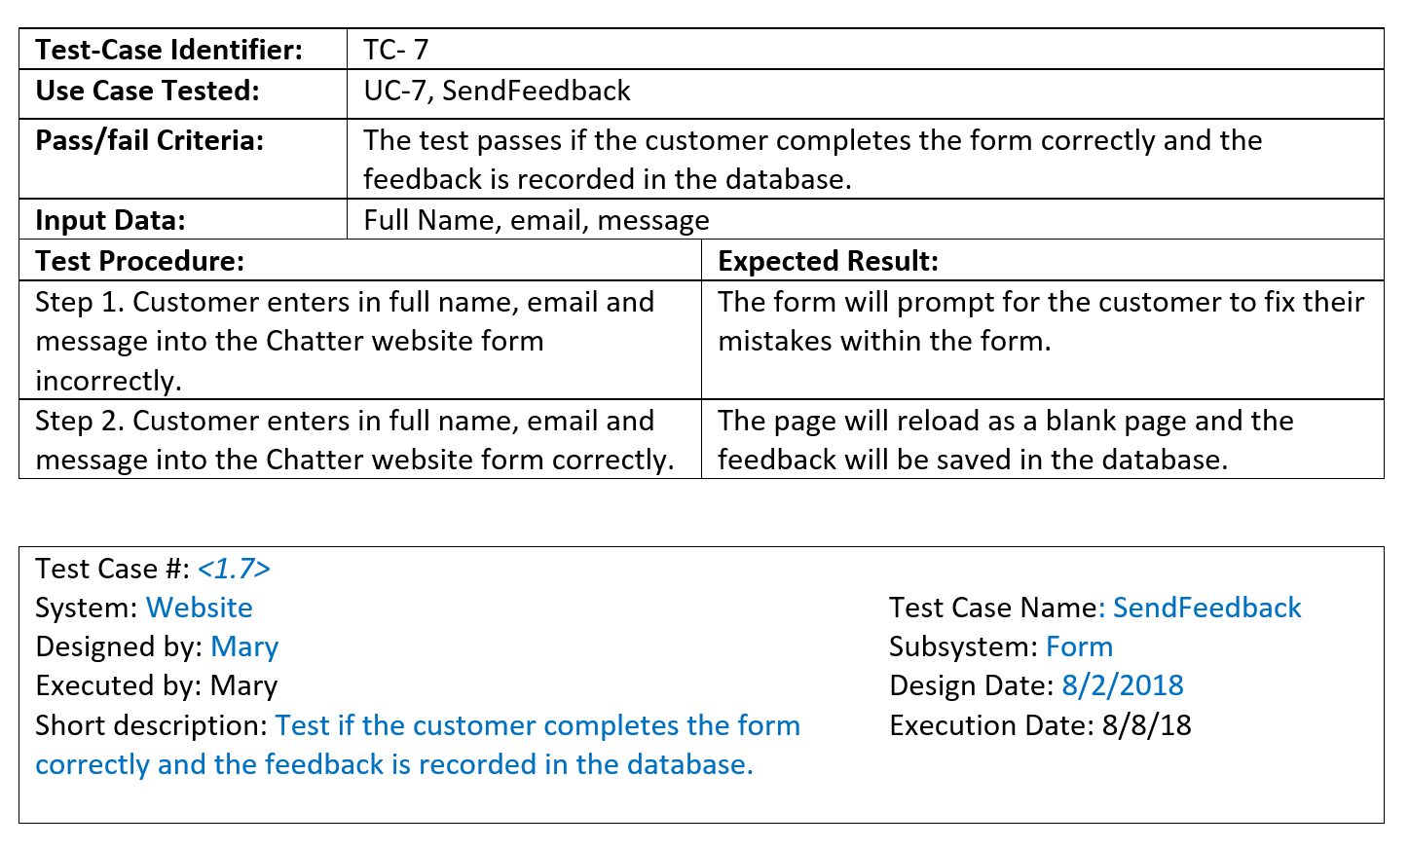
Key Test Cases Illustration
Website Feedback

Slide 10
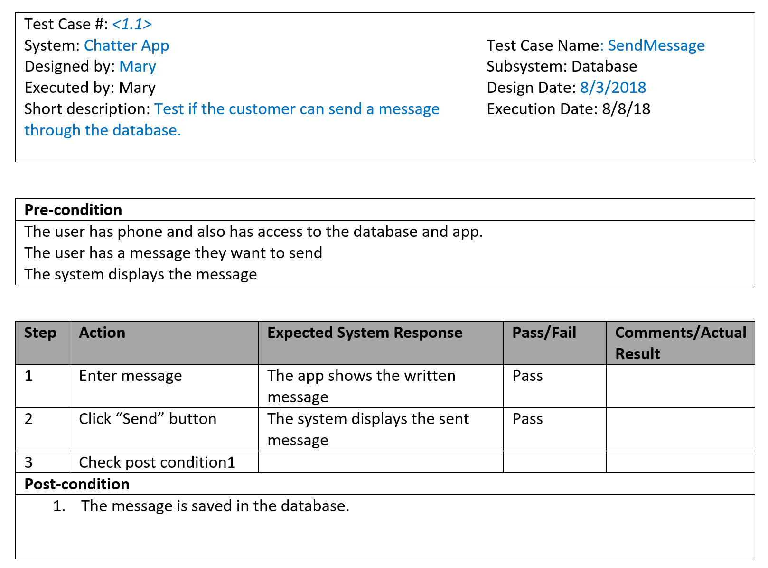
Key Test
Cases
Send Message

Slide 11
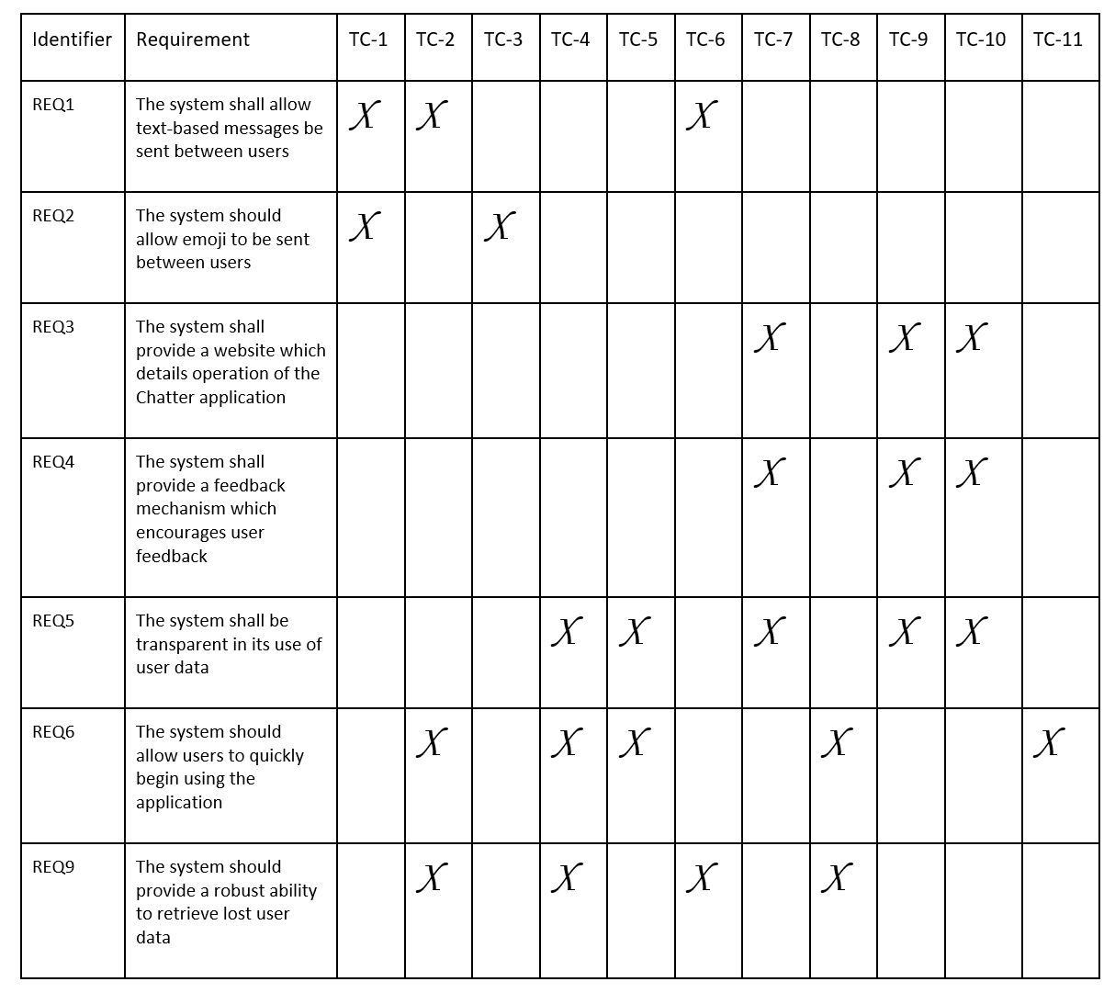
Traceability
Matrix

Slide 12

Questions

